Slide 1

CipherShield: Pioneering Multi-Key Cryptographic approach for File Encryption Using Dynamic Keys
-A Comprehensive Approach to Protecting Video based data
By:
Mohammed Abdul Lateef
M. Tech - CFIS - II Yr
22011DA802
JNTUH
Dissertation Project
Under the guidance of:
Dr. P. Swetha
Professor of Computer Science
Deputy Director, Directorate of Affiliations and Academic Audit
JNTUH

Slide 2
Agenda:
Introduction
Current System
Literature Review
Objectives
Use Cases
Proposed system
Modules of Proposed System
System Architecture
Performance Evaluation
Conclusion

Slide 3

1. Introduction
The growing importance of securing multimedia content, particularly video data, has made encryption a critical component in today’s digital landscape
Our work focuses on a custom video encryption algorithm designed to protect video files during transmission and storage.
The goal is to ensure data confidentiality, integrity, and resistance to unauthorized access while optimizing performance.

Slide 4
2. Current Challenges in Fortifying Video content
In conventional systems, video encryption is achieved through static key-based algorithms.
These systems often use standard encryption techniques like AES or RSA, which, while effective, can have certain limitations in scalability, and adaptability to various use cases.
Additionally, current solutions lack a robust mechanism for handling dynamic key management, which is essential for enhancing security against evolving threats.

Slide 5
The cryptographic solution proposed aims to elevate the data security by implementing a system that uses the encryption models as per the file types.
3. Literature Review
A Novel Hybrid Multikey Cryptography Technique for Video Communication
Yousef Fouzar and et. al. , ‘‘A Novel Hybrid Multikey Cryptography Technique for Video Communication’’ IEEE Access, vol. 11, Jan. 2023.
Each encryption iteration for next chunk of video data adds an additional layer of security, contributing to enhanced data protection.

Slide 6

4. Objective: -Implementing a Dynamic Software System for Real-Time Encryption
To develop a dynamic and efficient encryption system tailored specifically for video data.
To implement a multi-layered encryption approach combining RSA for key management and AES for chunk-wise encryption.
To ensure that encrypted videos remain secure during storage and transmission, even when dynamic keys are not stored.
To evaluate and compare the proposed system against traditional encryption techniques based on performance metrics like encryption/decryption time and key generation delay etc.

Slide 7
The cryptographic solution proposed aims to elevate the data security by implementing a system that uses the encryption models as per the file types.
5. Use Case
A multinational corporation regularly conducts sensitive board meetings and strategy sessions via video conferencing. Given the confidential nature of these discussions, ensuring the security and privacy of the video stream is paramount.
Secure Video Streaming: Protects sensitive video content during transmission over public or untrusted networks.
Confidential Video Conferencing: Encrypts live or recorded video streams to prevent interception or eavesdropping by unauthorized parties.
Media Archives: Protects long-term storage of sensitive video data, ensuring that even if the storage system is compromised, the data remains unreadable.

Slide 8
The cryptographic solution proposed aims to elevate the data security by implementing a system that uses the encryption models as per the file types.
6. Proposed Solution and Highlights
The proposed system introduces a hybrid video encryption algorithm, leveraging the power of fundamental equation of ECC along with both RSA and AES encryption techniques.
RSA handles key management, encrypting the dynamic AES keys for each video chunk.
AES key is generated using ECC equation is used for encrypting video data in chunks, providing efficient encryption for large file sizes.

Slide 9
The cryptographic solution proposed aims to elevate the data security by implementing a system that uses the encryption models as per the file types.
7. Modules of Proposed System
Following are the list of modules crafted for proposed system
User Authentication Module: Ensures that only authorized users can upload or access encrypted videos.
Video Upload and Encryption Module: Encrypts video files using the hybrid RSA-AES technique, dividing videos into chunks and encrypting each chunk with dynamically generated AES keys.
Dynamic Key Management Module: Manages the generation, storage, and encryption of dynamic keys for each video chunk using RSA.
Decryption and Playback Module: Enables authorized users to decrypt video chunks and stream the video seamlessly.
Metrics and Performance Evaluation Module: Measures encryption and decryption time, file size impact, and system scalability to provide comprehensive performance insights.

Slide 10
8. System Architecture

Slide 11
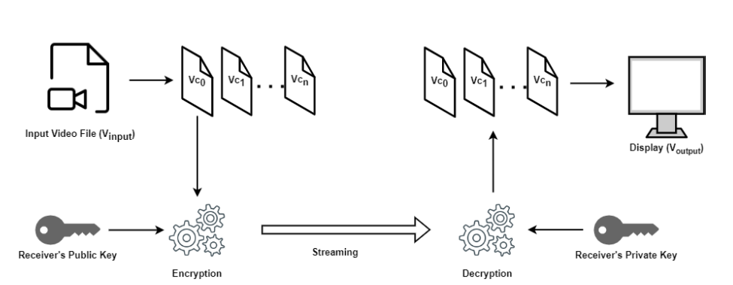
8.1. Video Communication Process
Figure 1: Implemenation of video chunking

Slide 12
Generate ‘n’ Video Chunks from video input
Generate 128 bit AES key from ECC equation using GUID
Encrypt each video chunk with AES key and encrypt the AES key using RSA
Use the key generated by previous chunk for the next chunk. * First chunk gets the input from first 128 bits(16bytes) of Video data
Concatenate encrypted AES key, GUID to the first encrypted video chunk
8.2 Approach

Slide 13



8.3 Key derivation from ECC Equation
ECC Equation
(1)
$$K_{master}=\sqrt{\left(x^{3}+VID∗x+GUID\right)mod\left(2^{256}\right)}$$
The equation considers
int(VID) as ‘a’
int(GUID) as ‘b’
x is the int value of the hash for VID/previous key generated as below
(Used only for the first video chunk)
(2)
$$K_{i−1}^{∗}=\sqrt{\left(x^{3}+K_{Prev}∗x+GUID\right)mod\left(2^{256}\right)}$$
(For generating keys of remaining video chunks)
(3)
$$x=int\left(sha256\left(VID\right)\right)$$
(For encrypting chunks other than first chunks we use enhanced GUID to make next key generated independent.)
(4)

Slide 14
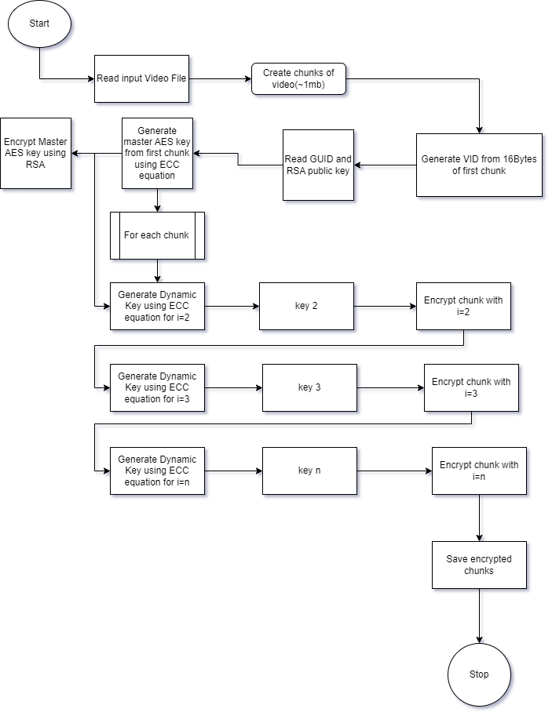
8.4 Architecture for Encryption
Figure 2: Encryption flow for algorithm

Slide 15
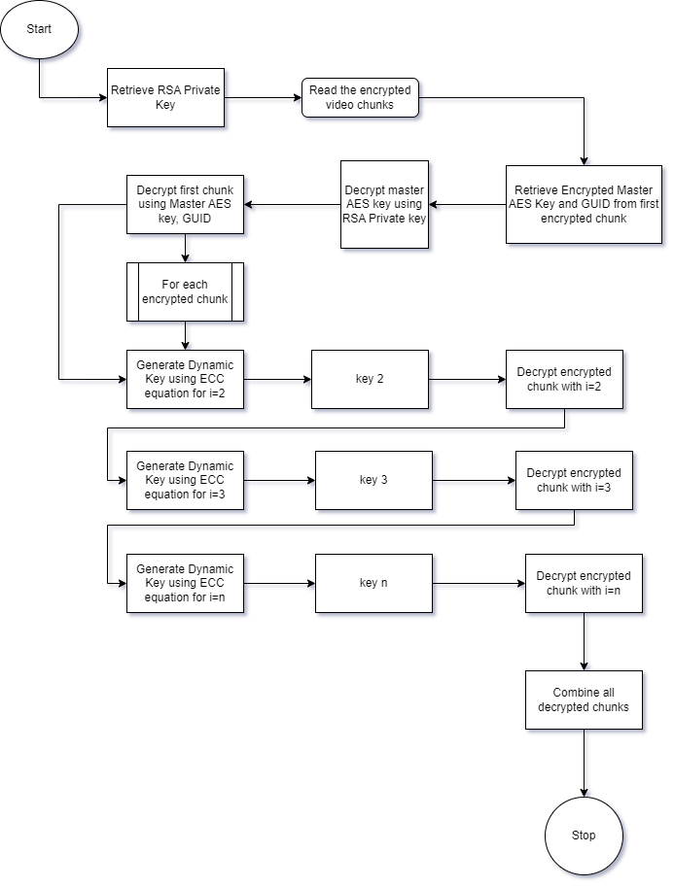
8.5 Architecture for Decryption
Figure 3: Decryption flow for algorithm

Slide 16
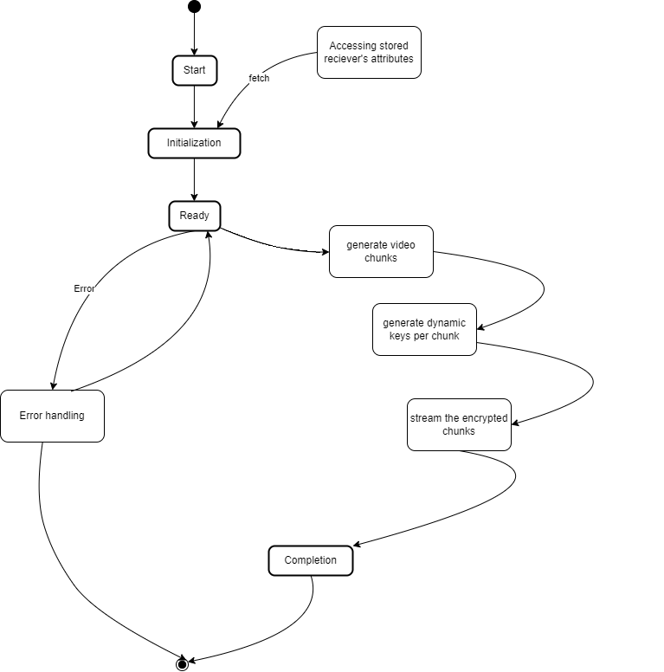
9. System Architecture
- State Diagram
Figure 4: State of system during encryption

Slide 17
9. Performance Evaluation
1
2
3
4
5
Time taken to Chunk the video
Time taken generate dynamic keys for the chunks created
Time taken to Encrypt the video file using dynamic keys generated.
Number of Keys Generated
Time taken to Decrypt the video chunks

Slide 18
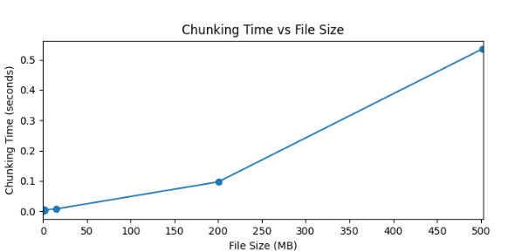
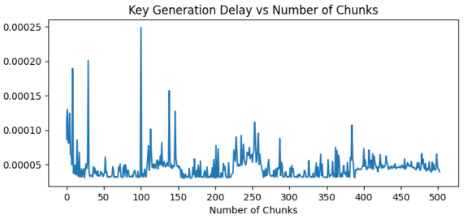
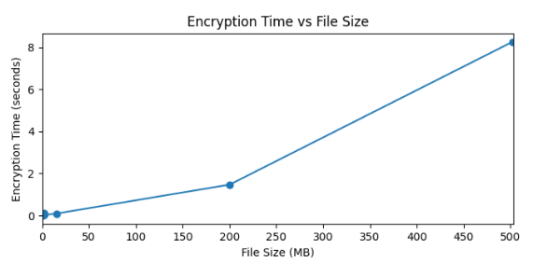
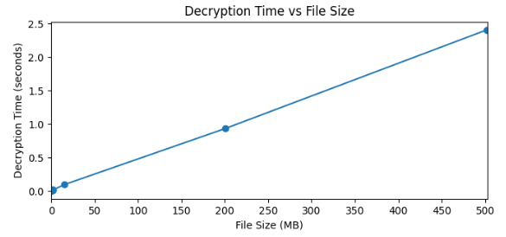
9. Performance Evaluation
Contd...

Slide 19
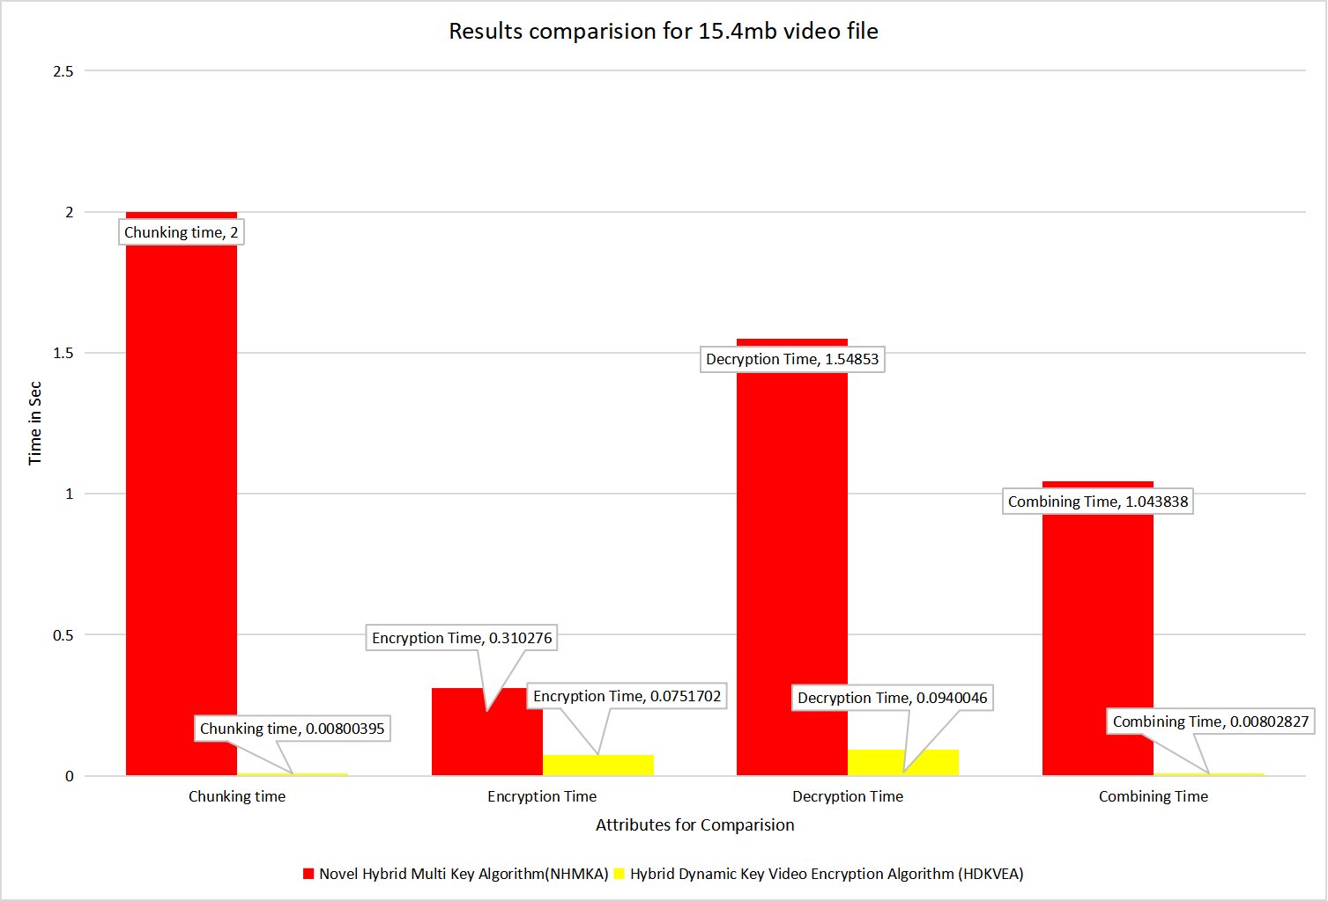
9. Performance Evaluation(result comparision)
Contd...

Slide 20
10. Conclusion
The proposed video encryption system demonstrates a novel approach to securing video data through a hybrid encryption model that combines RSA and AES.
By introducing dynamic key generation and management, the system enhances security and exhibits a high degree of adaptability and future-proofing while maintaining performance efficiency.
This solution provides a robust method for safeguarding video content in various use cases, from secure video streaming to digital rights management, making it an ideal choice for modern video encryption needs.

Slide 21
Reference
Y. Fouzar, A. Lakhssassi and M. Ramakrishna, "A Novel Hybrid Multikey Cryptography Technique for Video Communication,"
In IEEE Access, vol. 11, pp. 15693-15700, 2023
Doi: 10.1109/ACCESS.2023.3242616.

Slide 22


